Slide 1


Introduction to Flutter

Slide 2





Introduction to Flutter Framework
Fast development cycles
Native performance
Expressive and Flexible UI design
Highly Interactive apps

Slide 3
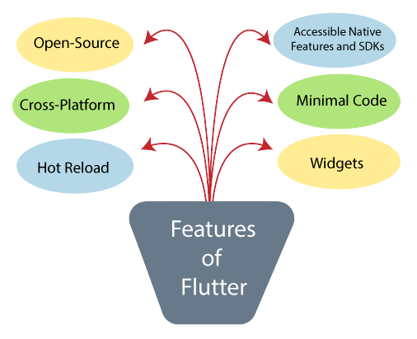
Features of Flutter

Slide 4
Advantages of Flutter
Dart has a large repository of software packages which lets you to extend the capabilities of your application.
Developers need to write just a single code base for both applications (both Android and iOS platforms).
Flutter needs lesser testing.
Flutter’s simplicity makes it a good candidate for fast development.
With Flutter, developers has full control over the widgets and its layout.
Flutter offers great developer tools, with amazing hot reload.

Slide 5
Disadvantages of Flutter
Since it is coded in Dart language, a developer needs to learn new language (though it is easy to learn).
Modern framework tries to separate logic and UI as much as possible but, in Flutter, user interface and logic is intermixed. We can overcome this using smart coding and using high level module to separate user interface and logic.
Flutter is yet another framework to create mobile application. Developers are having a hard time in choosing the right development tools in hugely populated segment.

Slide 6


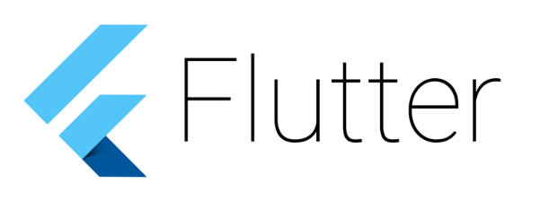
Flutter App Development
Android Studio
Visual Studio Code
Fluter sdk

Slide 7


