Slide 1

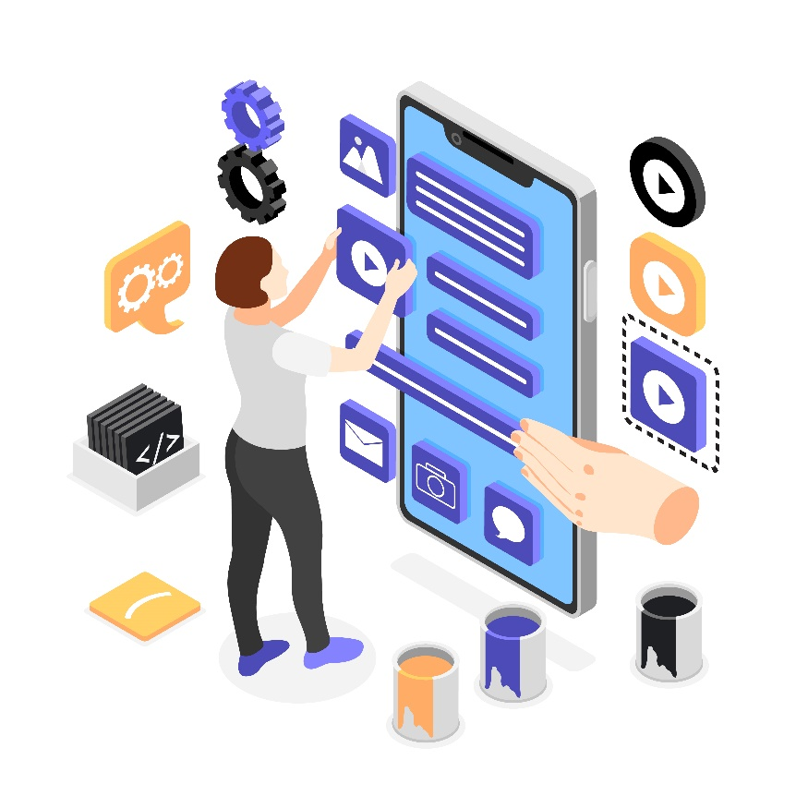
Introduction to Flutter Widgets

Slide 2
Introduction
Flutter is Google’s UI toolkit for crafting beautiful, natively compiled iOS and Android apps from a single code base.
To build any application we start with widgets – The building block of flutter applications.
Widgets describe what their view should look like given their current configuration and state.
It includes a text widget, row widget, column widget, container widget, and many more.

Slide 3
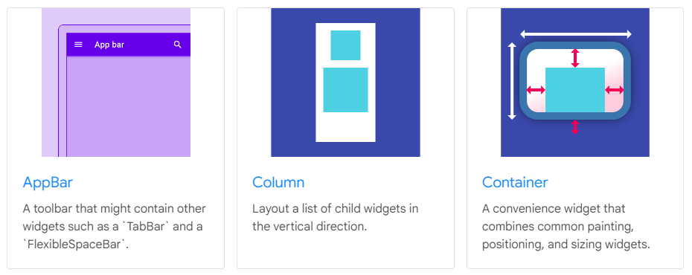
Basic widgets

Slide 4
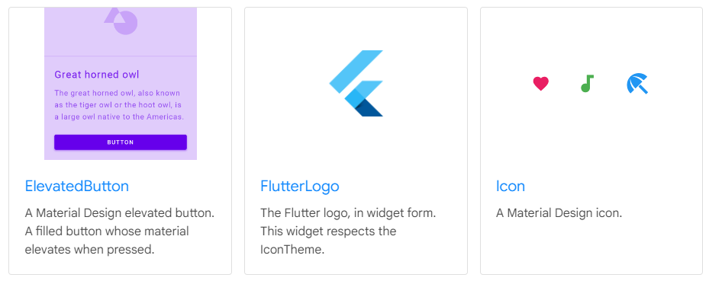
Basic widgets

Slide 5
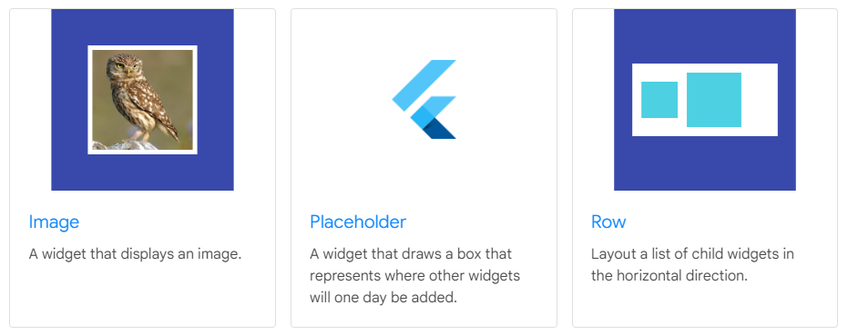
Basic widgets

Slide 6
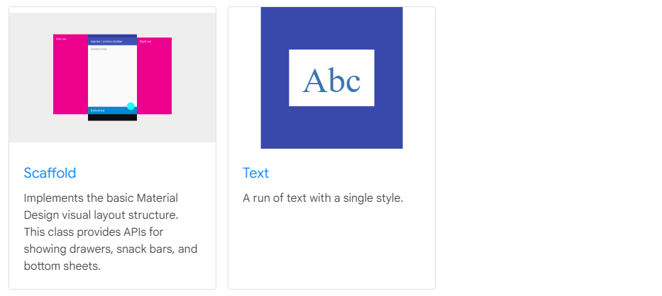
Basic widgets

Slide 7


